Slide 1
Enquiry Launch
Tuesday 23rd February 2021

Slide 2
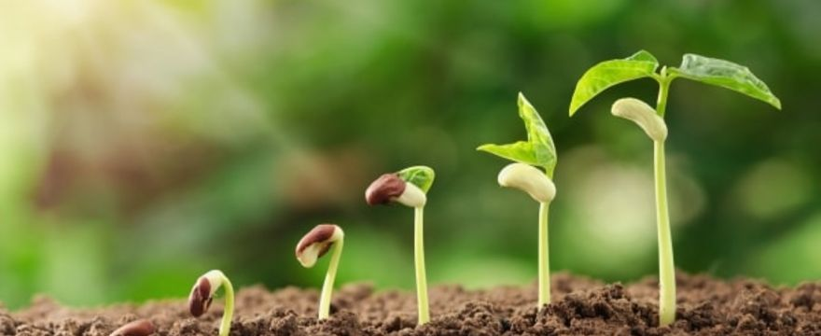
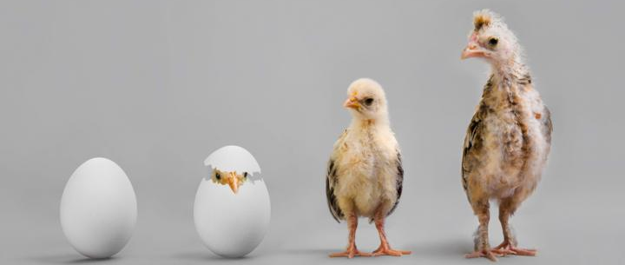
Can you always see things grow?

Slide 3
Task
Create a mind map of questions that you would like to discover during our enquiry.
You might want to find out…
How do plants grow?
How have communities grown overtime?
What is a growth mindset?
What do plants need to grow and mature?
How is food grown in the UK and abroad?
Can you grow ideas?
How do humans change as we grow older?
Are there things that are constantly growing?

