Slide 1
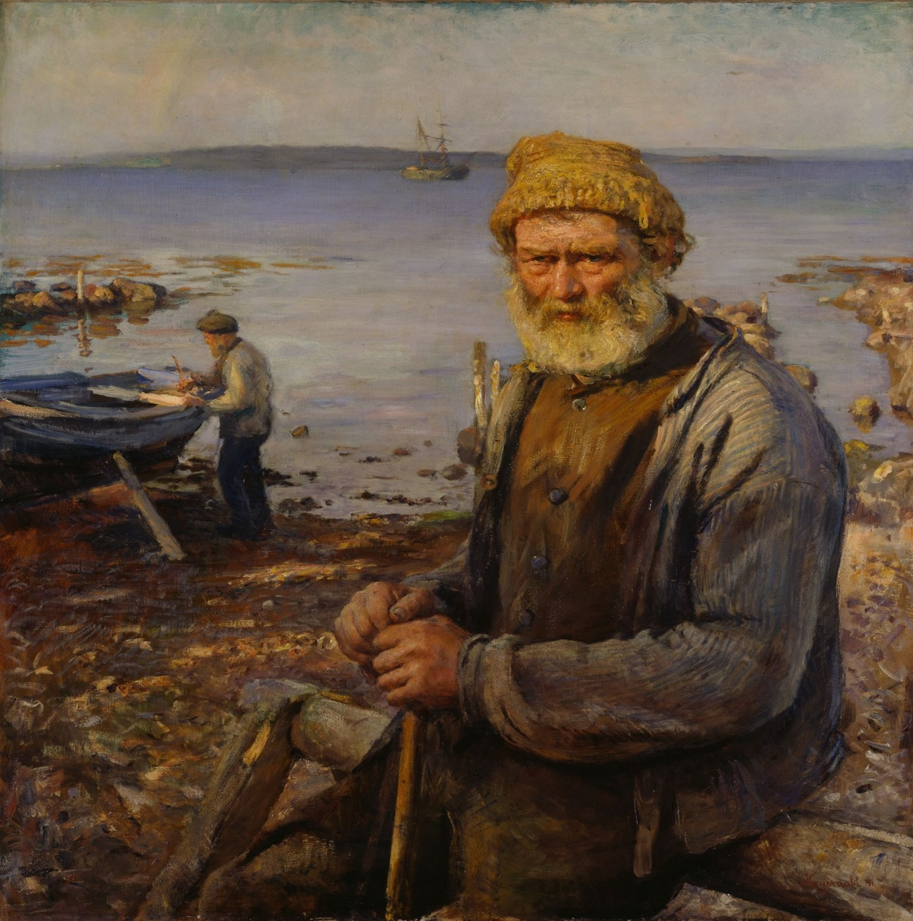
Character Description

Slide 2
Character Description
You can learn a lot about a character if the author has used certain language devices to describe. Last week, you used MAPOS to describe a setting, but not all these devices are useful for character descriptions. You can use similes, metaphors and alliteration but you also need to think carefully about verbs, adjectives and adverbs to show not tell how a character behaves, thinks or feels.

Slide 3
Show, don’t tell!
One way of making your character coming to life is to SHOW rather than TELL.
Example: David was in a furious temper.
David stomped to his desk spilling coffee as he went. Pushing past a group of people, he threw himself into his chair. With one sweep of his hand, he cleared his desk and growled at the nearest secretary.
You need to use
Interesting verbs – find synonyms for frequently used words. Instead of walked – strolled, shuffled, sped
Adverbs – words that add information to the verb, describes HOW something is done. He strolled confidently, she shuffled slowly
Adjectives - describing words that tell you more about nouns.
All over the floor tiny, colourful, glittering pieces of paper floated playfully in the gentle draft created by the open window.

Slide 4
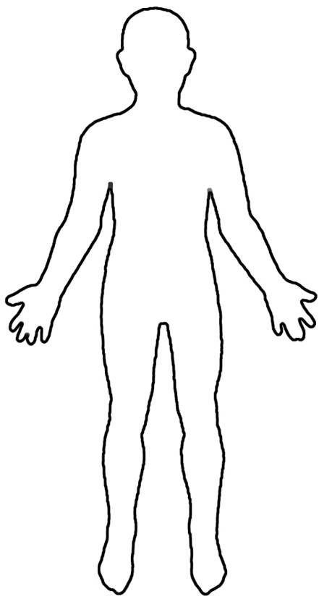
Readers infer or deduce, a bit like a detective, information about a character.
A reader can infer, or work out, what a character is like from the way they behave and the information they are given about them:
YOUR CHARACTER
Name?
Age?
Personality?
Likes and dislikes?
Appearance?
Interaction with other characters?

Slide 5
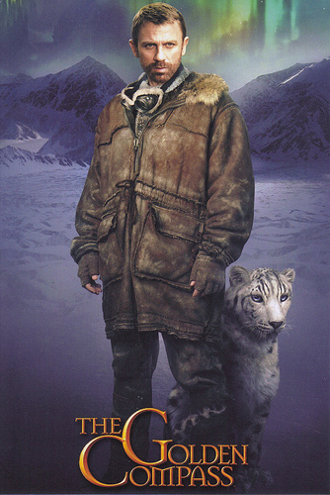
Read the description of Lord Asriel by Philip Pullman. Can you recognise some language features?
Lord Asriel was a tall man with powerful shoulders, a fierce dark face, and eyes that seemed to flash and glitter with savage laughter. It was a face to be dominated by, or to fight: never a face to patronise or pity. All his movements were large and perfectly balanced, like those of a wild animal, and when he appeared in a room like this, he seemed a wild animal in a cage too small for it.

Slide 6
Verbs
Adverbs
Similes
Metaphors
What are their facial features like?
What are they wearing?
Did they show NOT tell?
Lord Asriel was a tall man with powerful shoulders, a fierce dark face, and eyes that seemed to flash and glitter with savage laughter. It was a face to be dominated by, or to fight: never a face to patronise or pity. All his movements were large and perfectly balanced, like those of a wild animal, and when he appeared in a room like this, he seemed a wild animal in a cage too small for it.
Verbs: How they enter? (do they shuffle, stride, skip etc.)
Adverbs: How they move? (confidently, cautiously, briskly etc.)
Similes: Could you compare them to an animal? What could you compare their eyes/hair/smile etc. to?
Metaphors: E.g. his hands were flat spiders; she had a heart of stone
What are their facial features like? (E.g. small, shifty eyes could indicate they’re secretive; rotten teeth might suggest they neglect themselves)
What are they wearing? Style of clothes and colours? (E.g. brightly coloured clothes = confident)
Remember to show NOT tell.

Slide 7
Read the example on the next slide and look at how some of the devices have
been used.
Have a look at the rest of the character descriptions for inspiration and then fill in your Character description planning sheet adding as much detail as possible to help you write your description tomorrow.
Verbs
Adverbs
Similes
Metaphors
What are their facial features like?
What are they wearing?
Did they show NOT tell?

Slide 8
He stepped from the shadows - a menacing figure. Dark, greasy hair hung like limp spaghetti around his ears and a straight, wiry moustache sat above his thin lips. Hiding behind circular, shadowy glasses were cold, calculating eyes of frosted green. His heavy-knitted jumper, stiff from the cold, gave him a robot-like appearance; strangely at odds with the quiet rustling of his trouser leg against the sturdy boots. He concealed his intentions by stealthily moving towards the group gathered around the treasure, tightly clasping his crumpled up hat behind his back. The closer he got to the hunched up group, the closer …..
Alliteration
Powerful verbs
Adjectives and adverbs
Simile

Slide 9
Sharkey has clean-shaven face…corpse-like in its pallor, a high, bald forehead, a long, thin, high-nostrilled nose and — perhaps his most distinctive feature —filmy blue eyes, red-rimmed like those of a white bull terrier, from which strong men wince away in fear and loathing. Despite the tropical heat of the Caribbean, he wears a low fur cap; a blousy shirt under a red satin long-flapped waistcoat, a sword suspended from a many-coloured band of silk that pass across his body and a brass-buckled belt stuffed with pistols.
(Arthur Conan Doyle)

Slide 10
Now sitting at his desk, Norris peered through his eyeholes. He stared at Harvey Kenwright, pushing into other children as he stomped and stamped his way around the classroom, snarling and grunting like a wild beast. Harvey had a round, chubby face, with black, beady eyes all sunken in fat. He was a Great white shark, swimming around in a shoal of goldfish. His neck was the thickness of a small ham and his arms looked as if he’d borrowed them from some sort of enormous troll.
(Paul Delaney)

Slide 11
An old woman, short in stature, appeared from behind a long, yellow curtain. Shuffling along, she dragged her golden slippers through the grass. A tight, lilac headscarf, covered in a swarm of silvery stars, was wrapped around her head. Brown hair, tinged with fine flecks of grey, framed her wrinkle-infested face.
A long, crooked nose was standing to attention with several stray hairs protruding out its nostrils. Deep, dark shadows lay under her eyes, hanging still like silent, sleeping slugs. Enormous bronze earrings swung from her ears, dangling down in a perfect, symmetrical line.
(Paul Delaney)

