Slide 2
1
Statements
Statements are sentences which tell you a fact, opinion or idea.
Example:
A rainbow has 7 colours.
They are beautiful to look at.

Slide 3
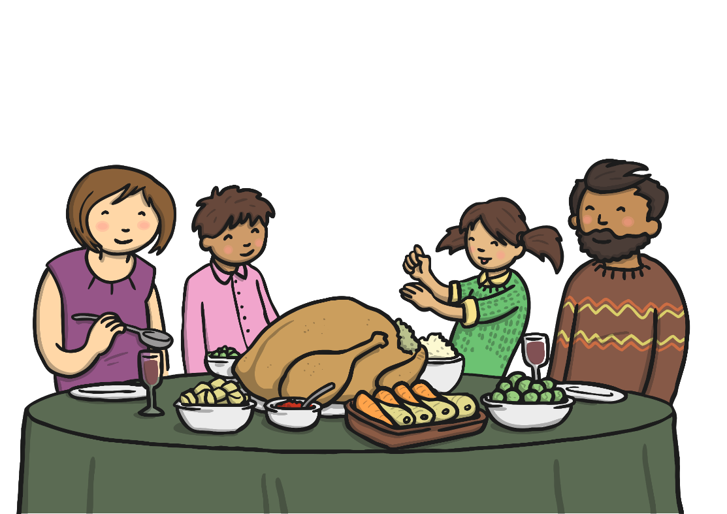
2
Questions
Questions are sentences that ask you something.
They usually end with a question mark.
Example:
What did you have for dinner?

Slide 4
3
Commands
They are often urgent or angry, can be very short and contain an imperative verb. Commands Imperative verbs are also known as ‘bossy verbs’- they tell people what to do.
Example:
Help me! Stop it.

Slide 5
4
Exclamations
An exclamation is used when someone is surprised.
It always starts with ‘How’ or ‘What’ and contains a noun and a verb.
Example:
What big feet you have!

