Slide 1
The following slides show just a small snapshot of Polperro Pupils’ learning from this half term

Slide 2
Penhallow Class Do all Superheroes Wear Capes?

Slide 3
Penhallow Class Do all Superheroes Wear Capes?

Slide 4
Penhallow Class Do all Superheroes Wear Capes?

Slide 5
Penhallow Class Do all Superheroes Wear Capes?

Slide 6
Penhallow Class Do all Superheroes Wear Capes?

Slide 7
Penhallow Class Do all Superheroes Wear Capes?

Slide 8
Landaviddy Class What is Light?

Slide 9
Landaviddy Class What is Light?

Slide 10
Landaviddy Class What is Light?

Slide 11
Landaviddy Class What is Light?

Slide 12
Landaviddy Class What is Light?

Slide 13
Landaviddy Class What is Light? Character Descriptions

Slide 14
Landaviddy Class What is Light? Terrific 2A sentences

Slide 15
Landaviddy Class What is Light?

Slide 16
Landaviddy Class Division problem solving

Slide 17
Landaviddy Class Screen free day pebble painting

Slide 18
Talland Class What is Infinity and Where is Beyond?

Slide 19
Talland Class What is Infinity and Where is Beyond?

Slide 20
Talland Class What is Infinity and Where is Beyond?

Slide 21
Talland Class What is Infinity and Where is Beyond?

Slide 22
Talland Class What is Infinity and Where is Beyond?

Slide 23
Talland Class What is Infinity and Where is Beyond?

Slide 24
Talland Class What is Infinity and Where is Beyond?

Slide 25
Talland Class Mastering the grid method

Slide 26
Talland Class My Space Log

Slide 27
Talland Class Screen Free Day

Slide 28
Chaipel Class What’s the Final Frontier?

Slide 29
Chaipel Class What’s the Final Frontier?

Slide 30
Chaipel Class What’s the Final Frontier?

Slide 31
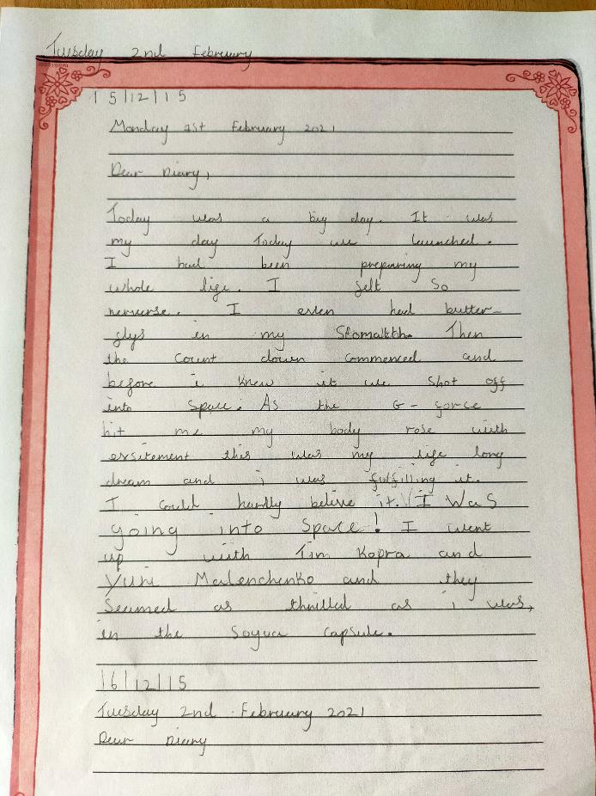
Chaipel Class Space Station Diary Entries

Slide 32
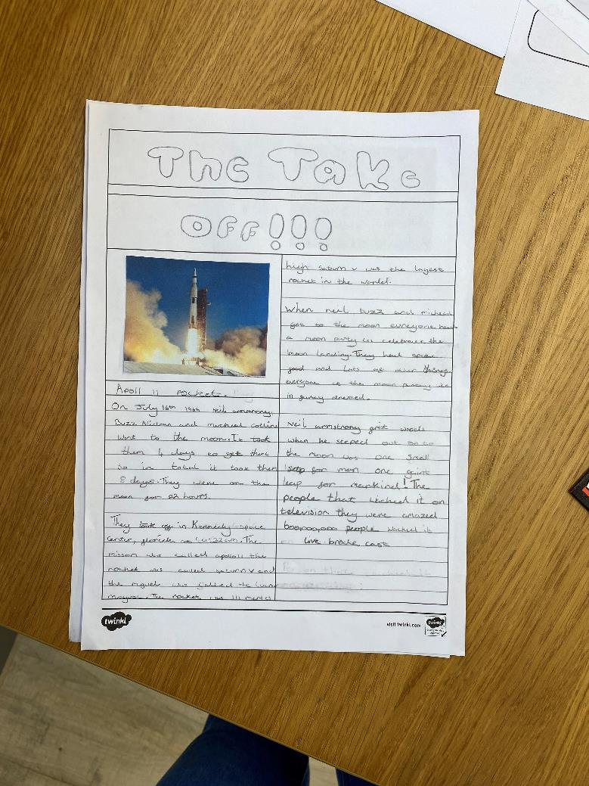
Chaipel Class Newspaper Report

Slide 33
Chaipel Class Conquering Fractions

Slide 34
Chaipel Class Meteor Science

Slide 35
Chaipel Class Learning to Code (Thank you Mr Dourass)

Slide 36
Chaipel Class Learning braille on our screen-free day

Slide 37
Well done everyone!

